Slide 1

Vel Tech Rangarajan Dr. Sagunthala R&D Institute of Science and Technology
School of Computing
Department of Computer Science and Engineering
10211CS224 / FULL STACK APPLICATION DEVELOPMENT (JAVA)
PROJECT REVIEW :– 2
Date: 20-04-2026
Movie Booking System
SDG 9 – Industry, Innovation and Infrastructure
Presented By:
MARAM AKASH– VTU24837 – 23UECS0800.
Courses Handling Faculty:
Dr. Hafizur Rahman- B.E., M.Tech., Ph.D

Slide 2
INTRODUCTION
1
Traditional movie ticket booking involves long queues, manual record-keeping, and frequent booking errors at counters.
Manual seat allocation leads to double-bookings, overbooking, and poor customer experience.
This project builds a relational database-driven web system to manage movies, shows, seats, users, and bookings.
It updates seat availability in real-time during bookings and cancellations, preventing conflicts.
Overall, it provides a scalable, reliable platform that improves convenience, reduces errors, and enhances the movie-going experience.
2
3
4
5
6
7
8
9

Slide 3
PROBLEM STATEMENT
Most cinema halls still use manual or paper-based booking systems with no real-time seat tracking.
This causes double-bookings, unavailable seat information, and long queues at ticket counters.
Errors in recording bookings and cancellations result in seat mismatches and revenue loss for theatre owners.
Lack of a centralized system makes it difficult to manage multiple screens, shows, and showtimes efficiently.
Therefore, an automated and reliable movie booking system is needed to improve accuracy and customer satisfaction.
1
2
3
4
5
6
7
8
9

Slide 4
OBJECTIVE(S)
1
2
3
To design and develop a web-based movie booking system that enables users to browse movies, view available showtimes, and book seats online in real-time.
To implement automated seat availability updates and booking confirmations to eliminate double-bookings and improve the overall user booking experience.
4
5
6
7
8
9

Slide 5
PROPOSED SYSTEM
A relational database-driven web application that manages movies, theatres, screens, showtimes, seats, users, and bookings efficiently.
It provides real-time seat availability tracking, ensuring accurate booking status for every show at all times.
The system prevents double-bookings by automating seat locking and maintaining data consistency using primary and foreign keys.
It solves issues like overbooking and seat conflicts by giving instant booking confirmation and availability alerts.
It improves operational efficiency by reducing the time required to browse, select, and book movie tickets online.
The system enables better business insights through reports on booking trends, popular movies, and revenue data.
It offers scalability, allowing the platform to handle a large number of concurrent users and bookings without performance issues.
Compared to traditional methods, it is more reliable, secure, and easily integrable with payment gateways and notification services.
1
2
3
4
5
6
7
8
9

Slide 6
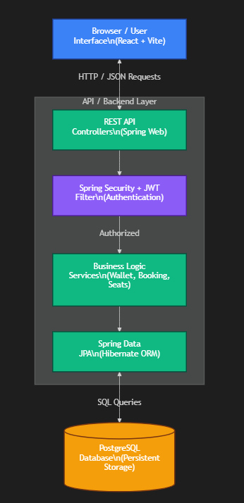
PROPOSED SYSTEM ARCHITECTURE
1
2
3
4
5
6
7
8
9

Slide 7
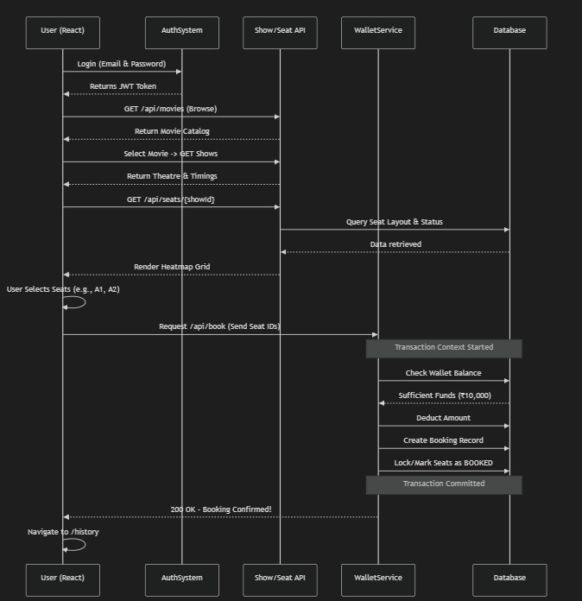
WORKFLOW
1
2
3
4
5
6
7
8
9

Slide 8
TECHNOLOGIES USED
Frontend:
HTML, CSS, JavaScript, ReactJs
Backend:
Spring boot, SpringDataJPA,Hibernate
Database:
PostgreSQL
Tools:
VS Code, Postman, pgAdmin, Git, GitHub, DBeaver
Hardware Requirements:
Laptop/Desktop, 4GB RAM (8GB recommended), Internet
Software Requirements:
Node.js, PostgreSQL, Web Browser (Chrome), VS Code
1
2
3
4
5
6
7
8
9

Slide 9
MODULE DESCRIPTION
Module 1: User Authentication
Handles user registration, login, and secure session management using JWT tokens.
Passwords are encrypted using bcrypt for security.
Role-based access differentiates admin and regular user capabilities.
Module 2: Movie & Show Management
Admins can add/edit/delete movies, theatres, screens, and showtimes.
Supports multiple screen management within a single theatre.
Ensures show schedules do not overlap on the same screen.
Module 3: Seat Booking & Availability
Displays available, booked, and locked seats for each showtime.
Prevents double-booking using database-level constraints.
Updates seat status in real-time after each booking or cancellation.
Module 4: Database Management
Stores users, movies, theatres, shows, seats, and booking records.
Ensures data consistency and integrity.
Supports efficient data retrieval and updates..
1
2
3
4
5
6
7
8
9

Slide 10
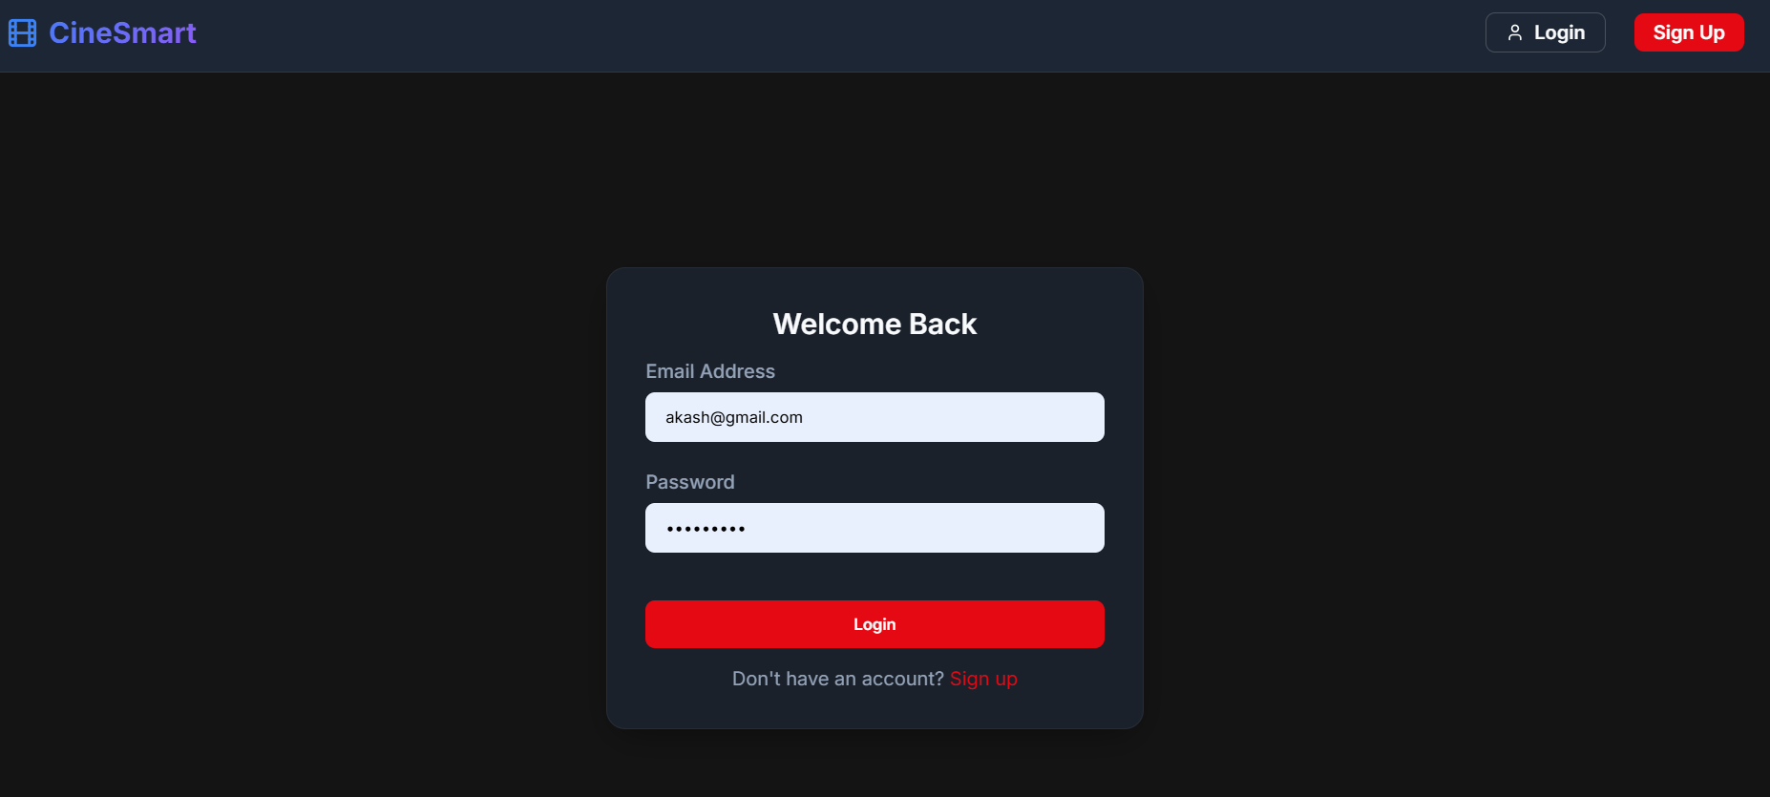
IMPLEMENTATION SCREENSHOTS
.
1
2
3
4
5
6
7
8
9

Slide 11
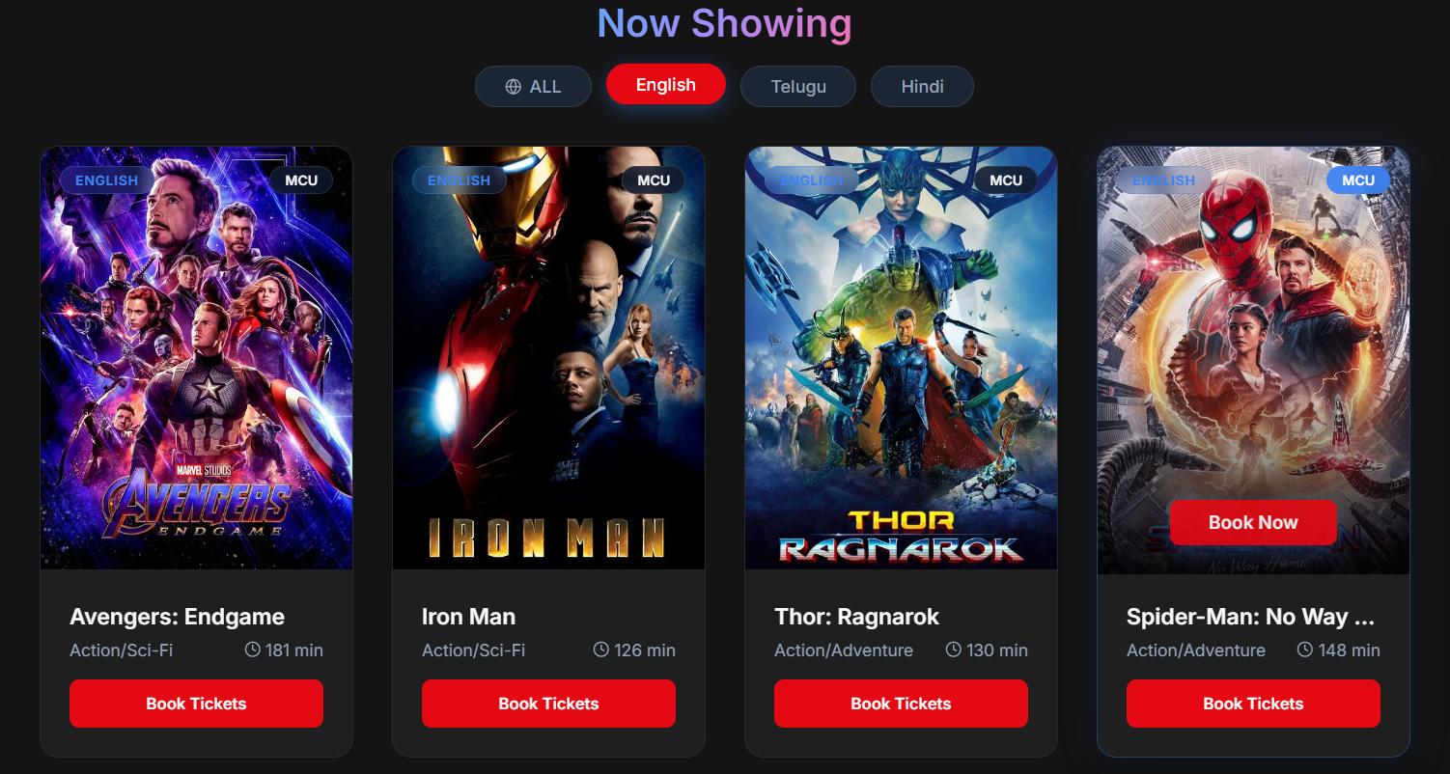
IMPLEMENTATION SCREENSHOTS
1
2
3
4
5
6
7
8(A)
9

Slide 12
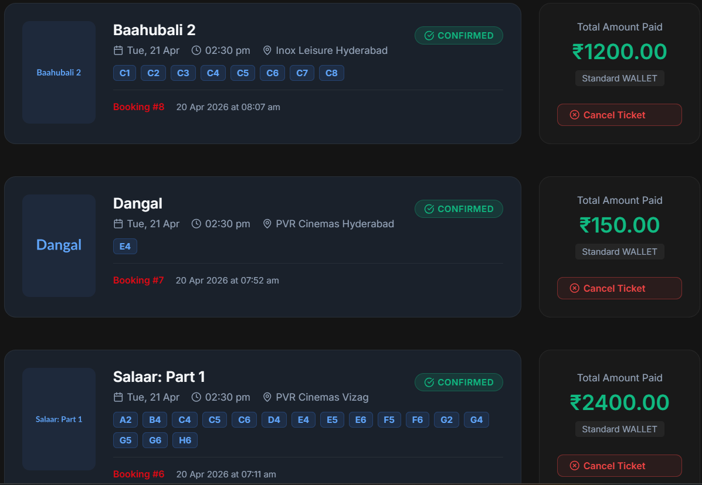
IMPLEMENTATION SCREENSHOTS
1
2
3
4
5
6
7
8(B)
9

Slide 13
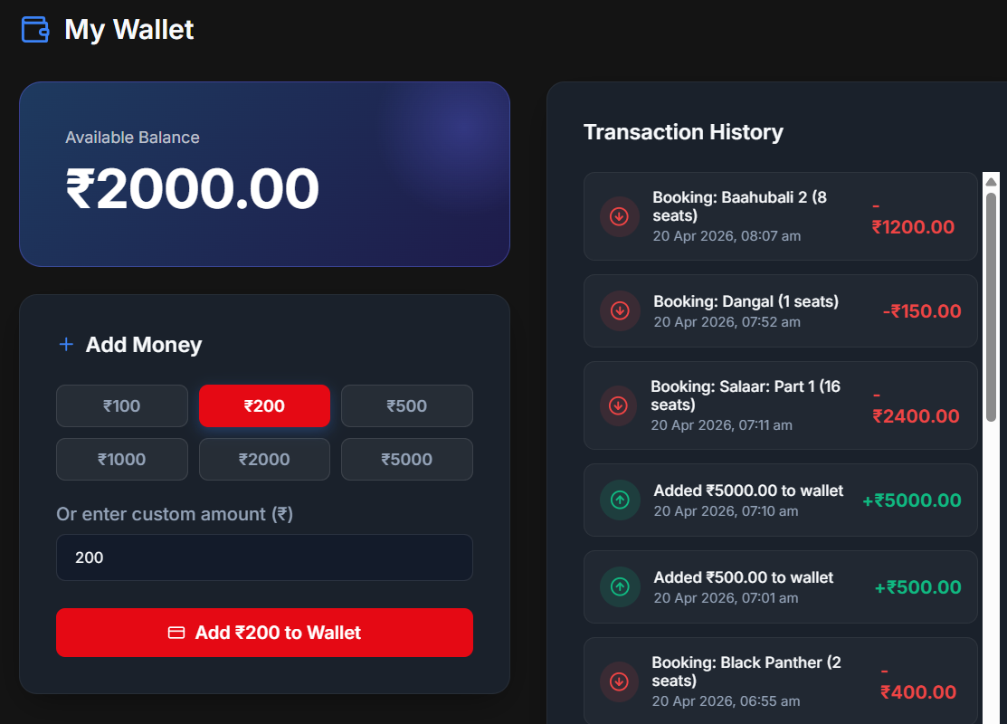
IMPLEMENTATION SCREENSHOTS
1
2
3
4
5
6
7
8(C)
9

Slide 14
ADVANTAGES & LIMITATIONS
1
2
Advantages
Real-time seat availability updates after every booking and cancellation
JWT-based authentication ensures secure and role-protected access for users and admins
Modular design makes the system easy to maintain and extend.
Centralized PostgreSQL database ensures data consistency.
Limitations
Basic frontend with limited user experience.
No integrated payment gateway (mock/simulated payments only).
No real-time seat locking during simultaneous bookings by multiple users.
Limited analytics and reporting features.
3
4
5
6
7
8
9

Slide 15
Thank you

